Slide 1

HOMEVALUE
ANALYTICS
Analysing House Prices for Smarter
Pricing Decisions
Analysis by;
(aspiring)Dr. Paul Gideon WABWIRE

Slide 2

Presentation Outline
01
02
03
Price Predictor Analysis
Brief analysis on what influences the price of a house
Pricing and Impact
Overview of all house price predictors and implications
Recommendations
Key take away from the housing data analysis

Slide 3
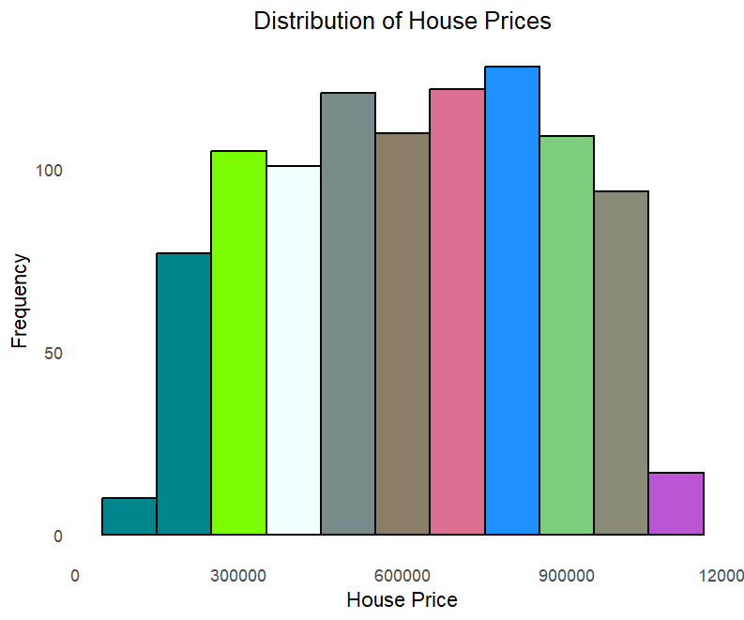

Slide 4
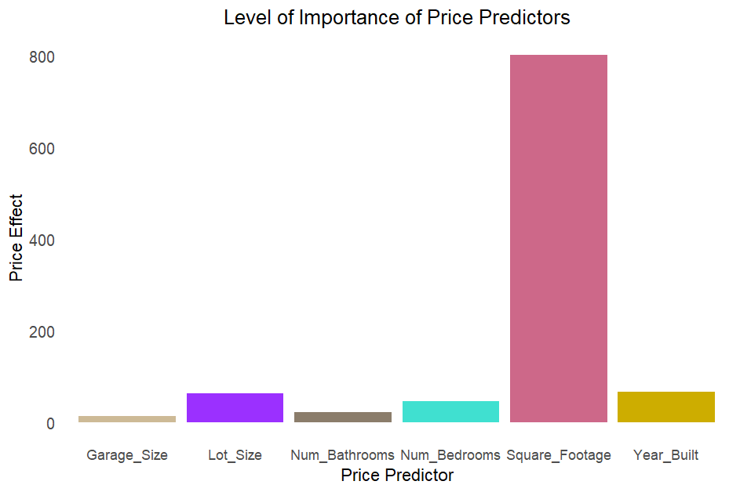

Slide 5
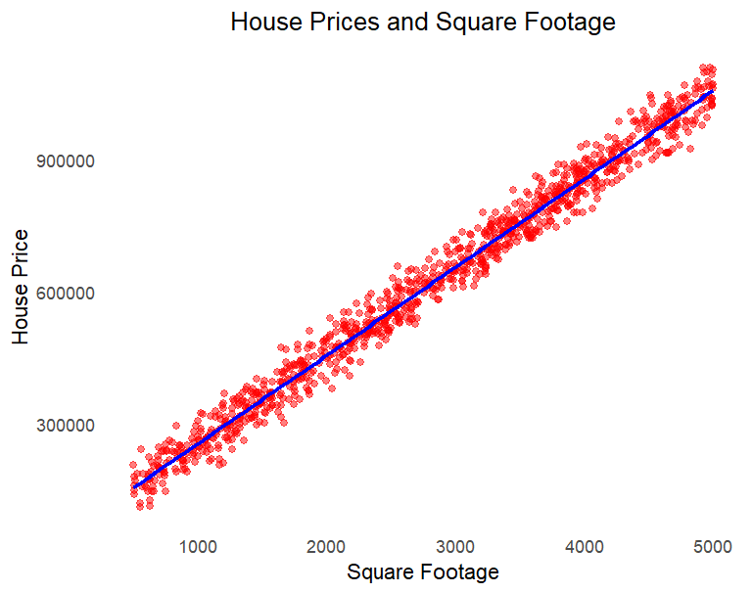

Slide 6
Predictor’s Monetary Impact
Square Footage
£ 251,
000
£ 20,
000
Year Built
Lot Size
£19,
000
£ 14,
000
Bedroom
Bathroom
£ 6,
000
£ 4,
000
Garage

Slide 7
Mid-Market Strategy
5 bedrooms
1 bathroom
Add 4 bathrooms
House 44
Cost
Refurb
New
Price
£376,388
£409,511

Slide 8
House Price
Predictions
£423,771
1000
£726,250
995
£697,582
996
998
£966,543
997
999
£686,741
£577,093

Slide 9
Other Findings
House 726
500sqft
5 bedrooms
3 bathrooms
0ver 60 houses with 3 bathrooms and only 1 bedroom
5 bedroom houses with one bathroom are common in old houses

Slide 10

Key Take Aways
Larger homes sell
for significantly more
Segment the Market
Re-evaluate
Neighbourhood Data
Target Families and
Upsell Bathroom Upgrades

Slide 11
Coffee Time
It’s…

